Slide 1
G
Tomato Killer
AI TUTORING SYSTEM
To make studying ease and affordable

Slide 2
KEYWORD
W H W
WHY
HOW
WHAT
Why are we doing this? What are the reasons and justifications behind it?
How do we plan to do it, and what is our MVP?
What have we done and what specific results have been achieved?

Slide 3
1
First Part
WHY
Why are we doing this?

Slide 4

CUSTOMER
What do users need?
Key of best

Slide 5
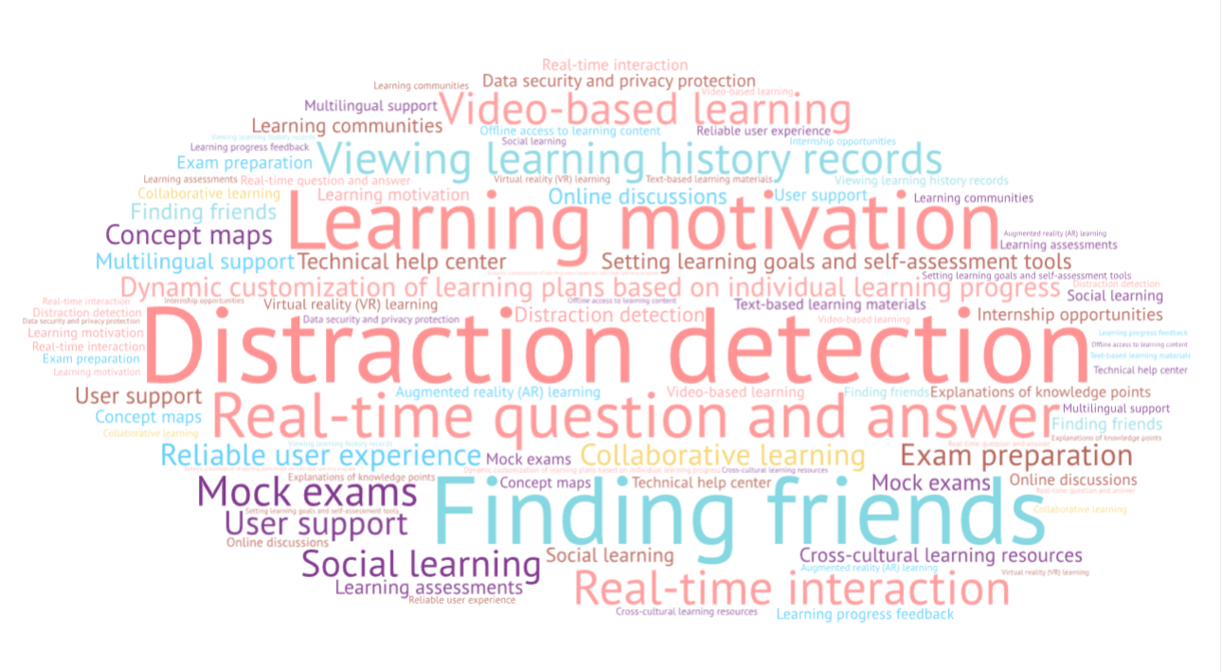
Notes:
分心检测
实时提问回答
根据自己学习情况动态定制学习计划
学激励
寻找好友
查看历史学习记录
视频学习
实时交互
社交学习
合作学习
可靠的用户体验
考试准备
模拟考试
学习目标设定和自我评估工具
多语言支持
跨文化学习资源
数据安全和隐私保护
用户支持
技术帮助中心
在线讨论
学习社区
知识点解释
概念图谱
学习测试
VR学习
AR学习
提供实习机会
可离线访问学习内容
文字材料学习
学习情况反馈

Slide 6



WHAT HAVE
EXPERT
DONE
Abdolhossein Sarrafzadeh
Abdolhossein et al. (2008) used facial expressions to analyze learning emotions, adjusting and interfering with students through vivid emotional agents.
Tanner Jackson
LEARN FROM EXPERT
Tanner and Danielle (2013) added the ideas of gaming into the iSTART system and enhanced the students' learning motivation.
Annabel Latham
Annabel combined with AI technology to adapt to learning styles, match their existing knowledge of learning style preferences; the system could use tips and hints to encourage learners to solve problems by themselves, and the system could give personalized feedback for the wrong time

Slide 7
KEYWORDS
LEARNING PROCESS
INPUT
Input
Output
Review
Features need to allow users to learn, which can be in the form of watching videos, reading text and interacting with games, etc.
Transform
OUTPUT
Features need to allow users to practice, which can be in the form of doing tests, writing notes, etc.
REVIEW
Features need to allow users to get feedback, that can give them insight into their learning.
Notes:
This allows us to determine what lessons we have learned and what still needs to be strengthened. Let's look at what the corresponding features need to be.

Slide 8
OUR IDEAL TUTORING SYSTEM
IDEAL SYSTEM

Slide 9













Login Module
Q & A Module
Learning Module
VR Module
System Module
Offline Module
Community Module
Brainwave Module
Monitoring Module
AR Module
Degree Module
AI NPC Module
Notes:
社区学习
实施问答
学习状态检测
实时调整学习难度
AI NPC
AR
VR
脑电波监测

Slide 10
Login Module
Q & A Module
HIGH
Learning Module
VR Module
System Module
Offline Module
VALUE
Community Module
Brainwave Module
Monitoring Module
AR Module
Degree Module
AI NPC Module
LOW
EFFORT
HIGH

Slide 11
MVP Evaluation
1. What user want
2. What the experts have done
3. Scientific learning process
4. Value & Effort

Slide 12
Login Module
Q & A Module
Learning Module
VR Module
System Module
Offline Module
Community Module
Brainwave Module
Monitoring Module
AR Module
Degree Module
AI NPC Module
Notes:
社区学习
实施问答
学习状态检测
实时调整学习难度
AI NPC
AR
VR
脑电波监测

Slide 13
Not necessary for now
Login Module
Q & A Module
Learning Module
VR Module
System Module
Offline Module
Community Module
Brainwave Module
Monitoring Module
AR Module
Degree Module
AI NPC Module
Notes:
社区学习
实施问答
学习状态检测
实时调整学习难度
AI NPC
AR
VR
脑电波监测

Slide 14
Nice to have
Login Module
Q & A Module
Learning Module
VR Module
System Module
Offline Module
Community Module
Brainwave Module
Monitoring Module
AR Module
Degree Module
AI NPC Module
Notes:
社区学习
实施问答
学习状态检测
实时调整学习难度
AI NPC
AR
VR
脑电波监测

Slide 15
Must have
Login Module
Q & A Module
Learning Module
VR Module
System Module
Offline Module
Community Module
Brainwave Module
Monitoring Module
AR Module
Degree Module
AI NPC Module
Notes:
社区学习
实施问答
学习状态检测
实时调整学习难度
AI NPC
AR
VR
脑电波监测

Slide 16
2
SECOND PART
HOW
How do we plan?

Slide 17



FUNCTION OF THE MODULE
Learning module
Login module
System module
1. Select a course
2. Select difficulty level
3. Select course unit
4. Learn the course
5. Take test
6. Get feedback
1. Register an account
2. Create an account
3. Login account
4. Reset password
1. Maintain system
2. Add course
3. Optimize courses

Slide 18
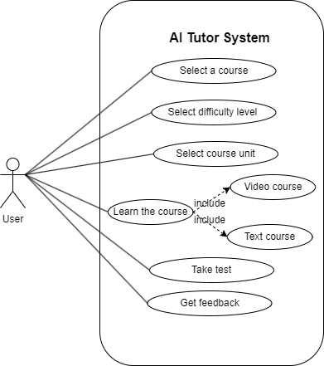
Learning module use case

Slide 19
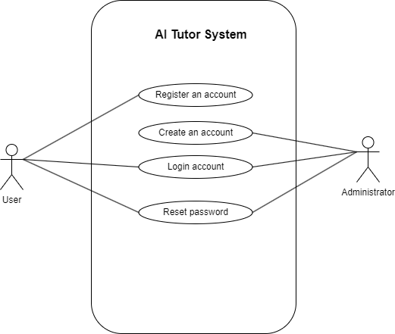
Login module use case

Slide 20
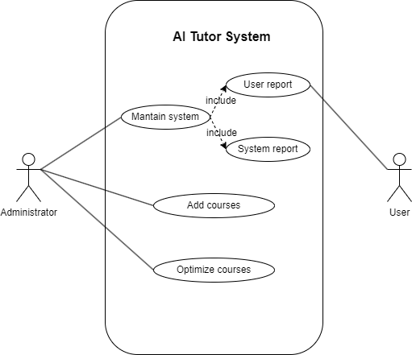
System management use case

Slide 21
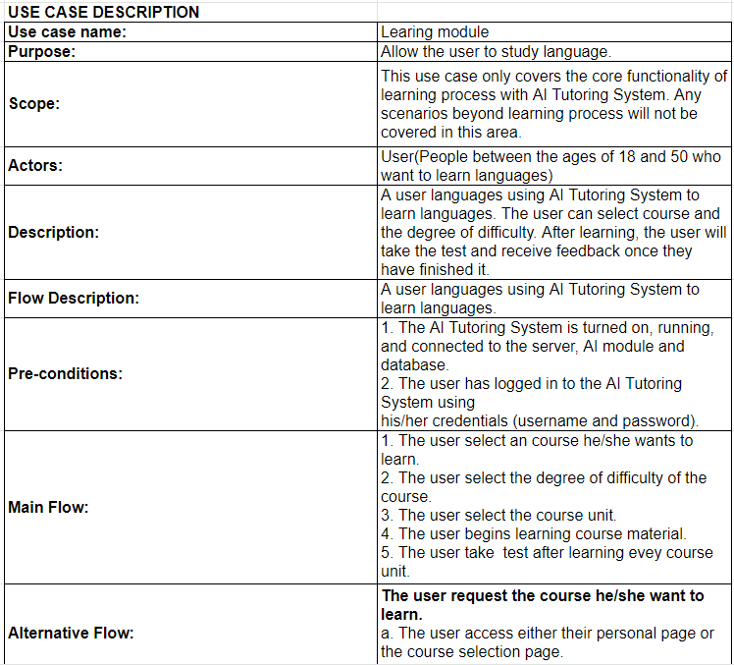

USE CASE DESCRIPTION
For more details, please click here

Slide 22
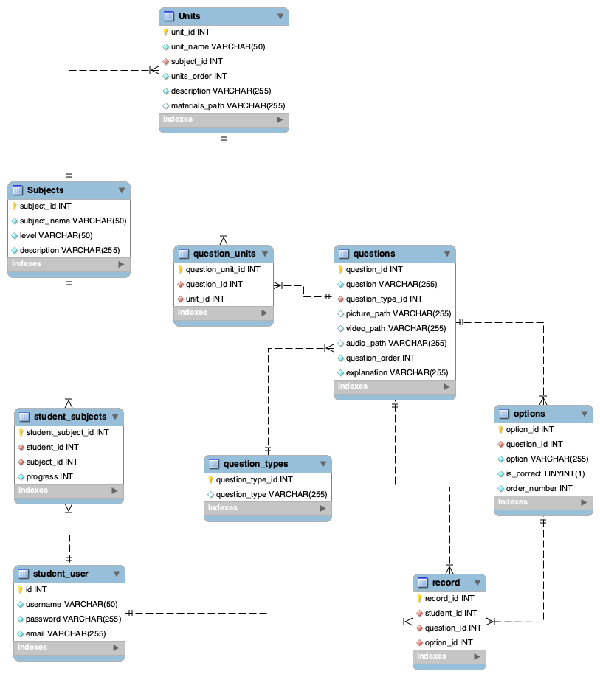
UML

Slide 23
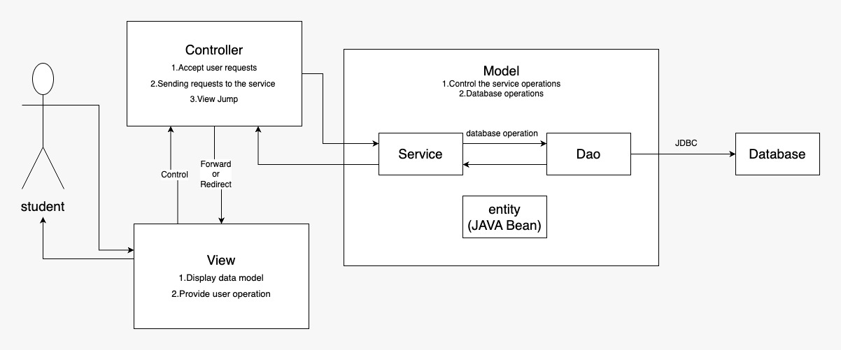
THREE TIER ARCHITECTUER

Slide 24
SYSTEM SEQUENCE DIAGRAM
———Select course

Slide 25
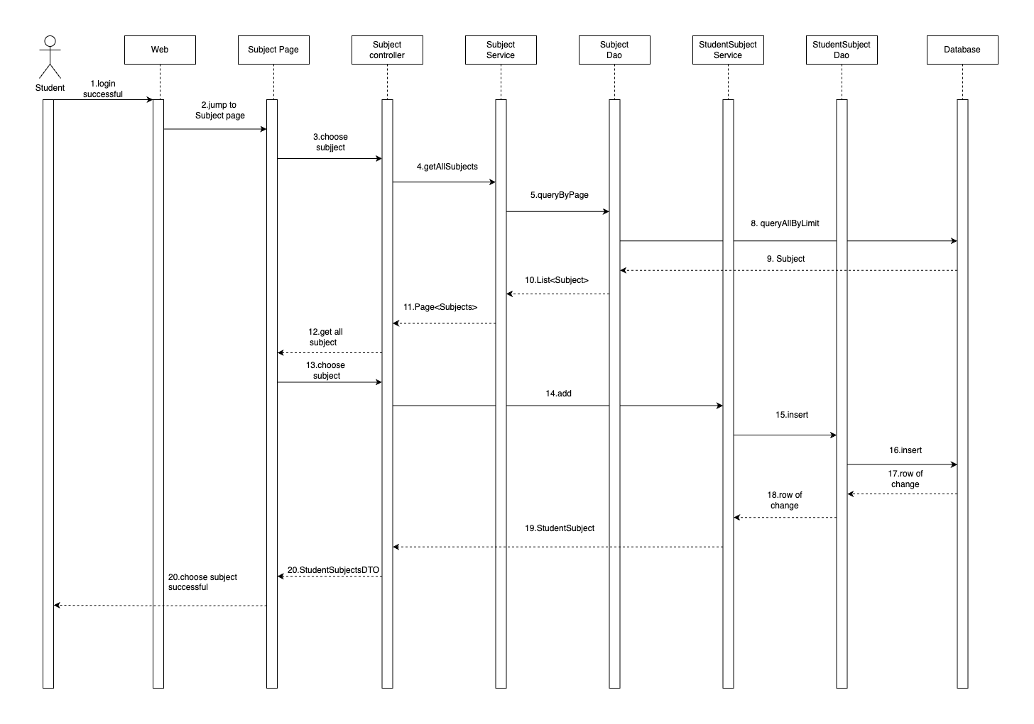

Slide 26
SYSTEM SEQUENCE DIAGRAM
———Take test

Slide 27
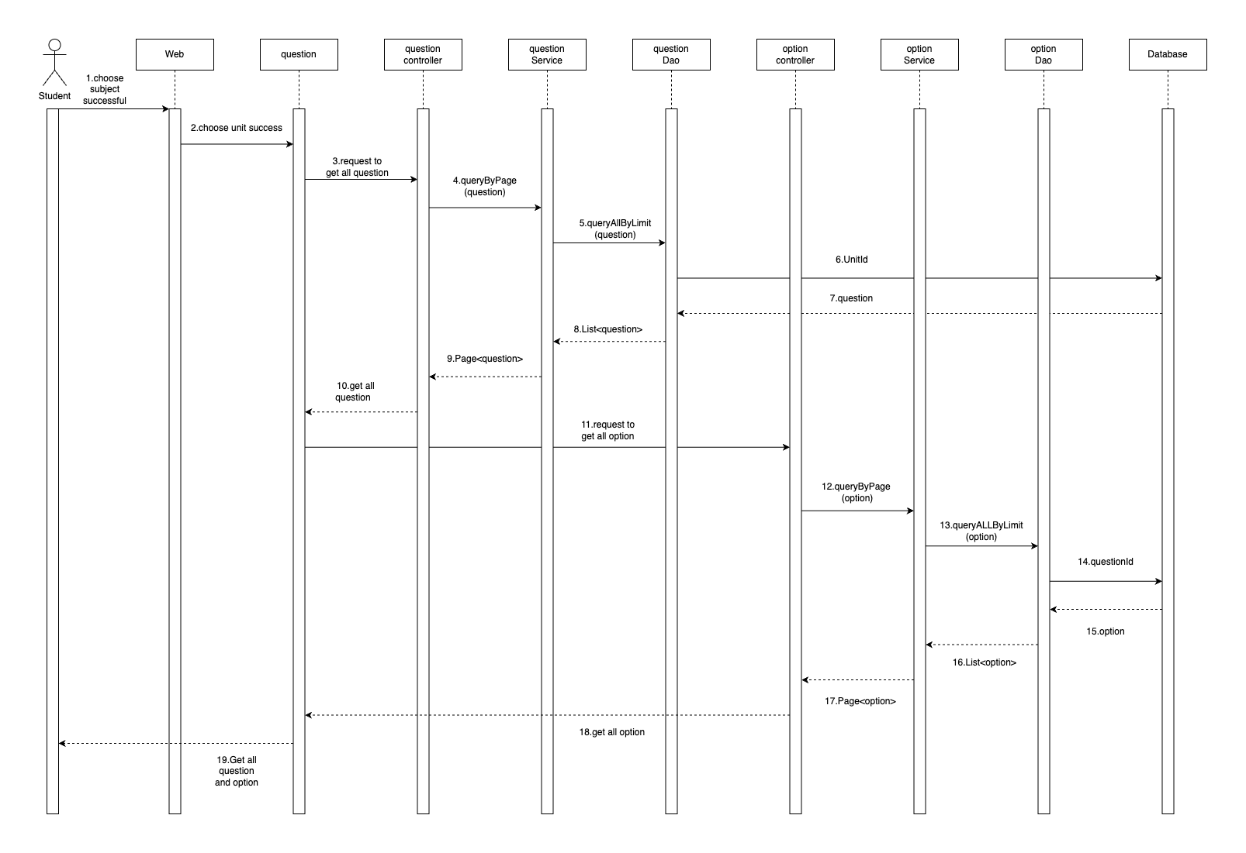

Slide 28
SYSTEM SEQUENCE DIAGRAM
———Choose unit

Slide 29
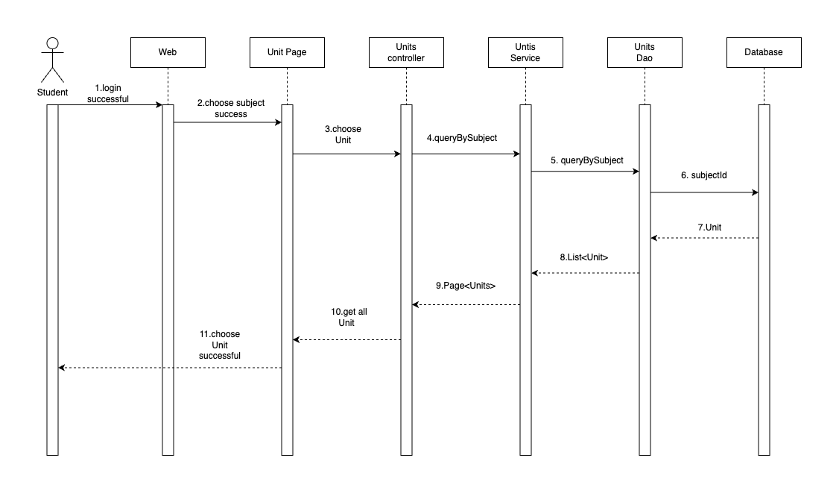

Slide 30
SYSTEM SEQUENCE DIAGRAM
———Register

Slide 31
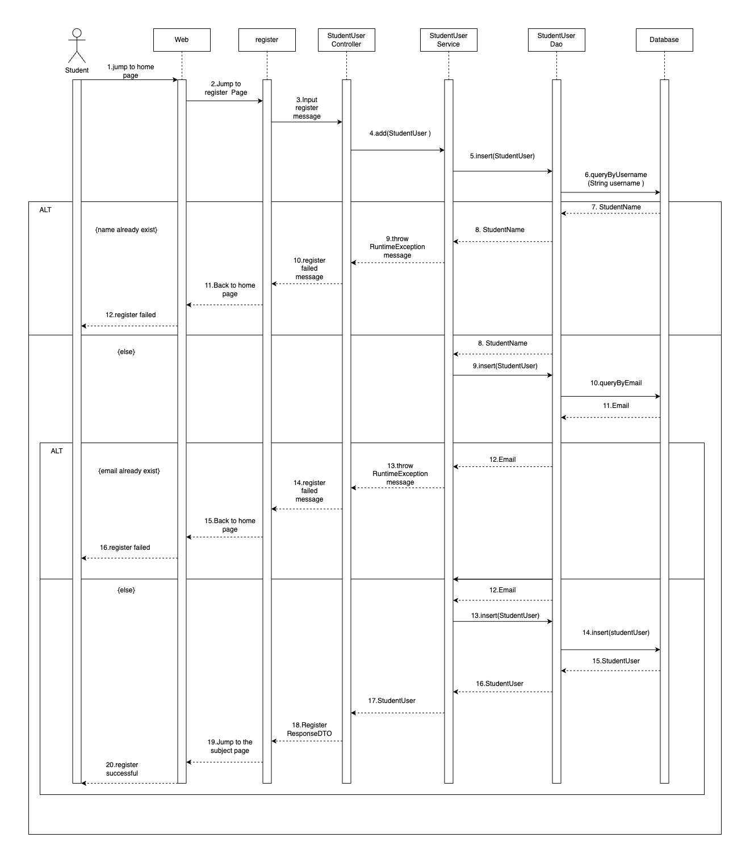

Slide 32
SYSTEM SEQUENCE DIAGRAM
———Login

Slide 33
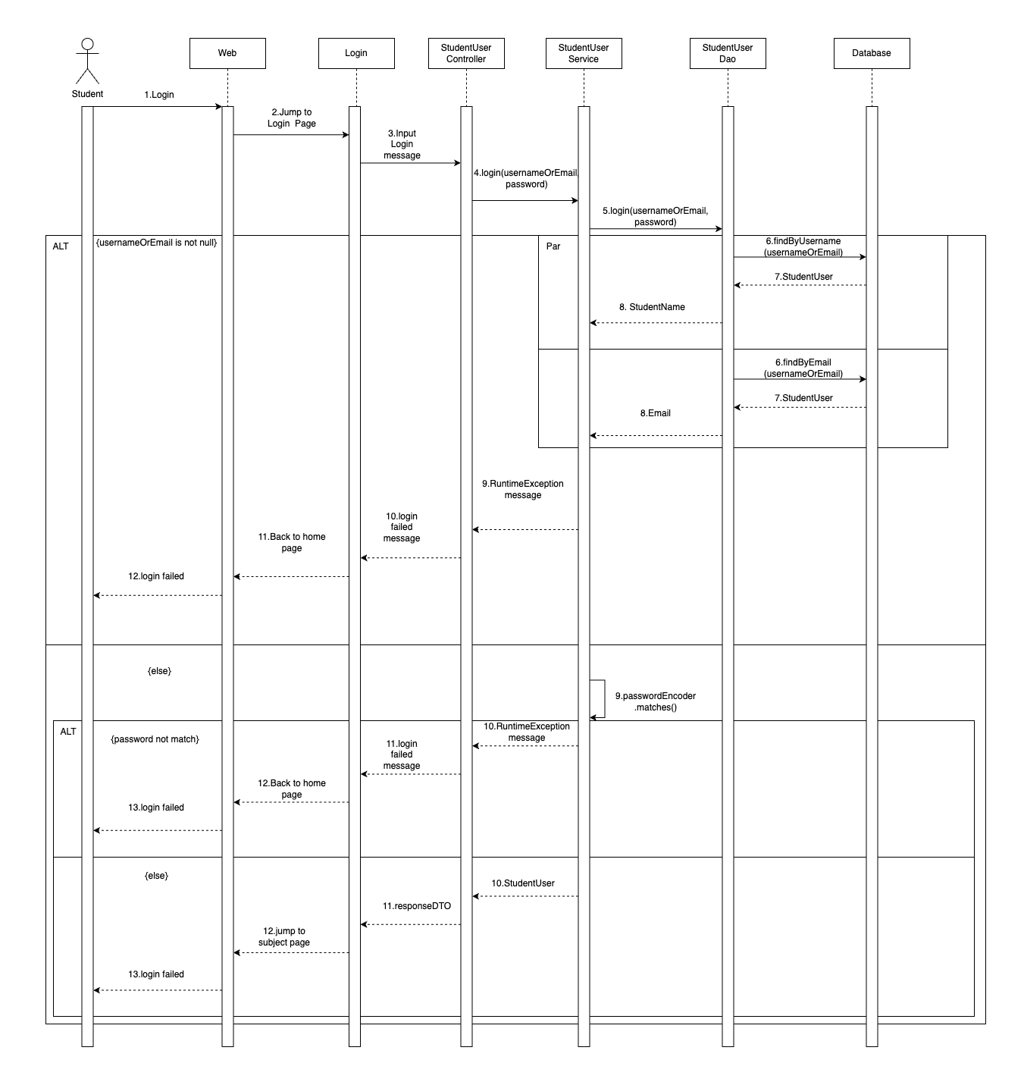

Slide 34
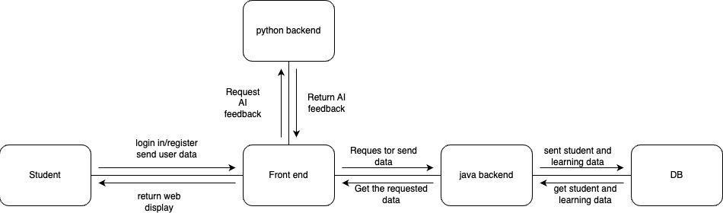
COMMUNICATION DIAGRAM

Slide 35
GLOSSARY
User: the user in question refers to individuals aged between 18 and 50 who are interested in learning a language.
Course: "course" refers to the materials provided in the system for users to learn, specifically focusing on Chinese language learning at the current stage.
Difficulty level: refers to the difficulty level of the learning courses. The difficulty levels can be categorized based on standards such as the HSK (Hanyu Shuiping Kaoshi) levels, which include six levels of difficulty.

Slide 36
GLOSSARY
Test: refer to the tests or assessments conducted after each chapter of the course. These tests are designed to evaluate the user's learning progress and comprehension. In the initial stage, the tests primarily consist of multiple-choice questions based on written content.
Feedback: refers to the feedback provided to users by an AI system after they have completed their learning and tests. The AI system analyzes the user's performance, identifies strengths and areas for improvement, and generates personalized feedback to guide their further learning. This feedback can include suggestions, explanations, and recommendations for additional study materials or activities.

Slide 37
GLOSSARY
Account: this account including two types of accounts in the system one will be user member and the other will be faculty member.
Maintain: refers to the activities performed by administrators to address issues or problems within the system. This includes resolving technical glitches, addressing user-reported issues, ensuring the smooth functioning of the system, and maintaining its overall performance and reliability. System maintenance is crucial for providing users with a seamless and uninterrupted learning experience.
Optimize: refers to the process of improving and refining the courses to better meet the needs and preferences of the users.

Slide 38
3
THIRD PART
WHAT
What have we done?

Slide 39



TECHNOLOGY STACK
Node.js (front-end): It allows us to build fast and scalable web applications. This lightweight, efficient environment runs JavaScript on the server side, leading to efficient and consistent development.
Java (back-end learning): It is a robust, secure and mature language that is widely adopted by enterprises. Its platform independence allows us to run it on any hardware and operating system, making our applications highly portable.
Python (back-end AI): It is known for its simplicity and readability, which accelerates development. In addition, Python has a rich ecosystem of artificial intelligence and machine learning that we can leverage to provide advanced intelligent coaching capabilities.

Slide 40



TECHNOLOGY STACK
MySQL (Database): As a mature relational database system, MySQL provides solid data integrity and supports the complex queries required by our applications.
AWS (Managed): AWS's cloud services provide us with on-demand computing and storage capabilities, allowing our servers to scale dynamically based on actual usage.
Docker (containerization): It encapsulates our application and its dependencies into a standardized unit for software development. This ensures that our application will run the same regardless of the deployment environment.

Slide 41


TECHNOLOGY STACK
Kubernetes (orchestration): It manages and scales our Docker containers with simple declarative configuration, allowing us to handle increased load and ensure high availability of our applications.
Jenkins (CI/CD): It automates our testing and deployment process, which leads to faster development cycles and faster delivery of features and fixes to our users. With Jenkins, we can ensure that our applications are always deployable.

Slide 42







DATA SOURCES
TUTORIAL VIDEOS
PRACTICE QUESTIONS
TEXTBOOKS

Slide 43
DATA SOURCES
Our *tutoring system* gathers data from various sources to provide comprehensive support to learners. We currently utilize *tutorial videos*, *practice questions* from reputable exams, *textbooks*, *teaching aids, and openly available **online resources*.
In the future, we plan to engage *the community by encouraging user contributions*. A dedicated platform or forum will enable learners to share their own questions and knowledge, expanding our available resources.

Slide 44
FUNTIONAL EVALUATION
The current plan and development direction aim to meet the users' most fundamental needs, but there is still room for improvement in terms of user experience and other aspects.
Login Module
System Module
Learning Module

Slide 45

USER EVALUATION
We will use Optimal Workshop to help us test the usability of our system. Through the features provided by the website, we can set tasks and generate links for users to test. By assessing whether users can find the required functionalities promptly, we can evaluate the system's effectiveness.

Slide 46
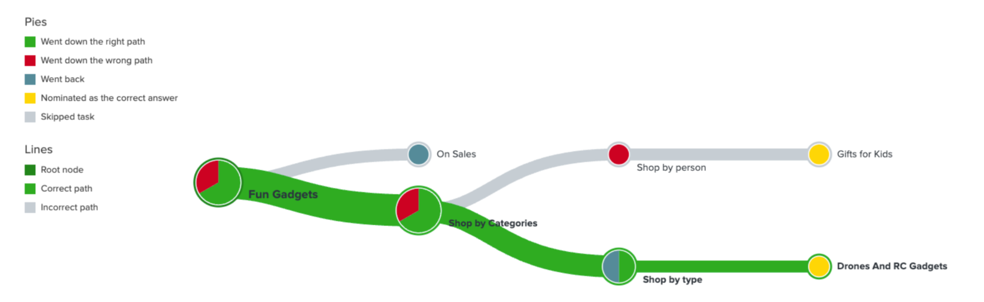
USER EVALUATION
▲Example of Pietree result. This is the paths through which users find the required functionalities.

Slide 47
RELIABILITY EVALUATION
Since our system is highly modular and deployed using k8s clusters, the system reliability is good.
Our k8s cluster has two nodes, each node is distributed in a different region, which ensures that we can provide services in case of a large-scale problem in one region of AWS.
Each subsystem has four pods running simultaneously, and only The system will stop serving when all modules of a subsystem stop working. 3. we use k8s deployment to manage pods so that when a pod stops due to an accident, a new pod will be deployed immediately and automatically

Slide 48
RELIABILITY EVALUATION
Problems with the current system:
The database module only runs one pod, and a standby database needs to be set up.
2. k8s clustering has not yet implemented the auto-scaling feature.

Slide 49
CURRENT STATUS
Functional progress: login/registration, choose difficulty/course, study/quiz, AI feedback.
Non-functional progress: cloud facility completed, docker and k8s environment set up completed.

Slide 50
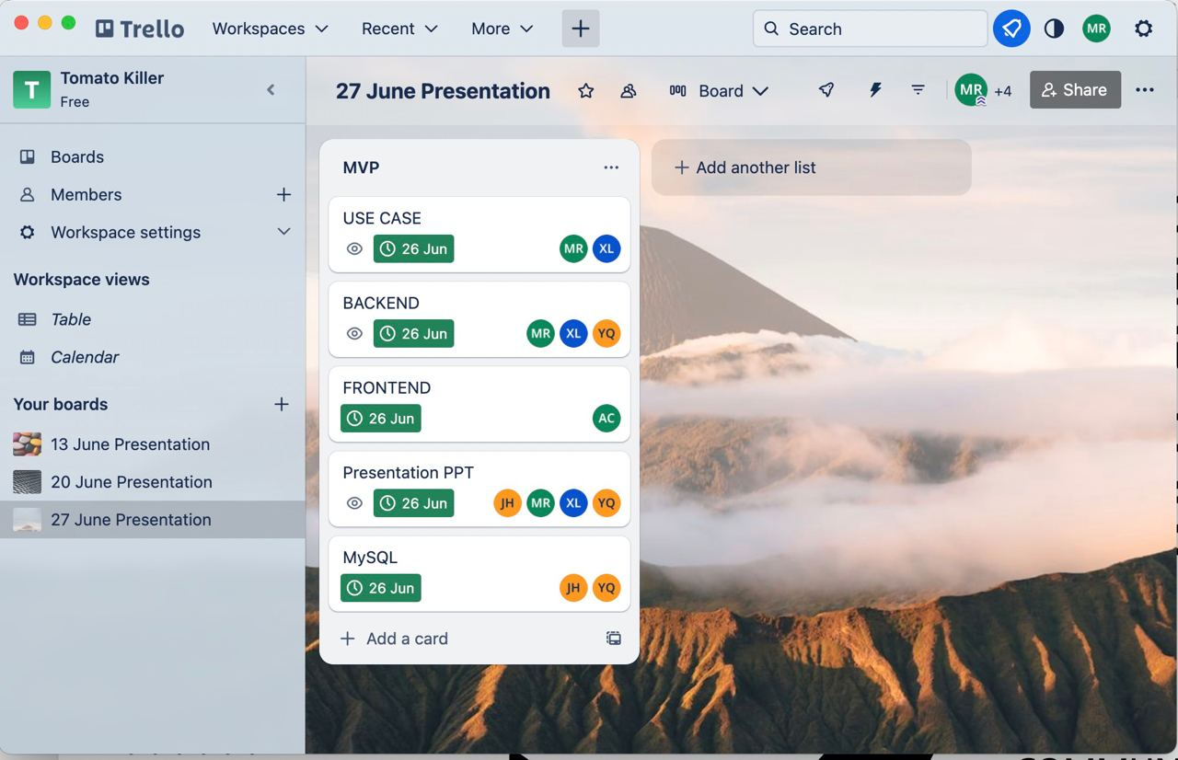
TEAM MANAGEMENT

Slide 51
TEAM MANAGEMENT
Due to one team member feeling unwell, the project did not progress as planned during the mid-term, resulting in team members working late nights in the last three days before the deadline. Next time, if we encounter a similar situation, we will initiate the contingency plan immediately.

Slide 52
CONTINGENCY PLAN
Unanticipated events
Organize a meeting
Implementation Solutions
Real-time progress reporting
Unanticipated events: This includes any unforeseen events or deviations from the planned course of action.
Organize a meeting: The project manager is available to organize a meeting to discuss solutions within 12 hours.
Implementation solutions: Execute solutions according to plan.
Real-time progress reporting: Any new development will be reported in WhatsApp group at the first time (no more than 12 hours).

Slide 53
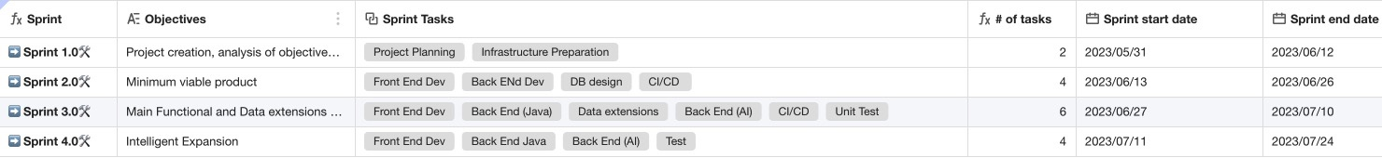
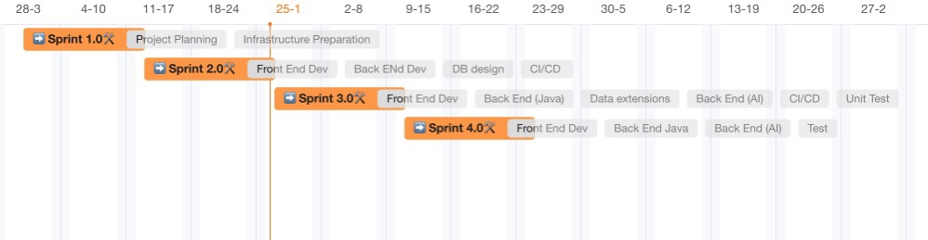
SPRINT PLAN

Slide 54
THANK YOU

